Slide 1
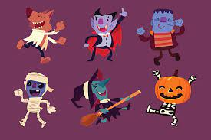
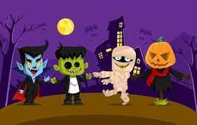
Monster Makey
By: Jasmine Roach, Kevin Rudio, Sam Downs

Slide 2
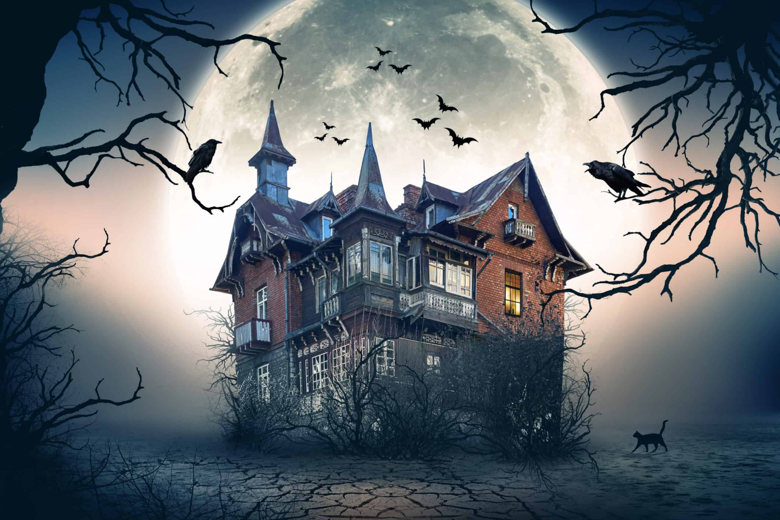
IDEA 1 - Haunted House Makey Makey
Decorate a small part of the room with Halloween decoration
Make playdoh into different objects that would be in a haunted house
Have students touch the different object and a noise with an image will pop up on a screen.

Slide 3
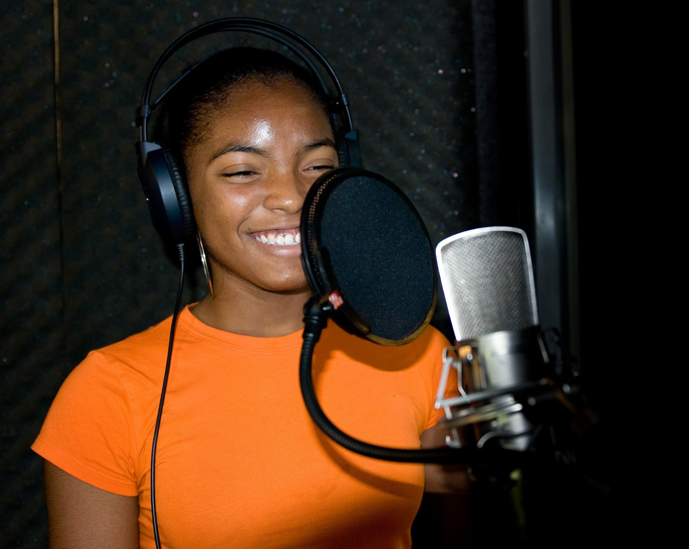
IDEA 2 - Create Your Own Sound Workshop
Students will learn the process of recording sound and implement them into makey makey.
Students may also have to choose from pre-existing sounds
Learn how the equipment work and how they interact with Makey Makey
Can save and combine sound recordings to make something cool at the end

Slide 4
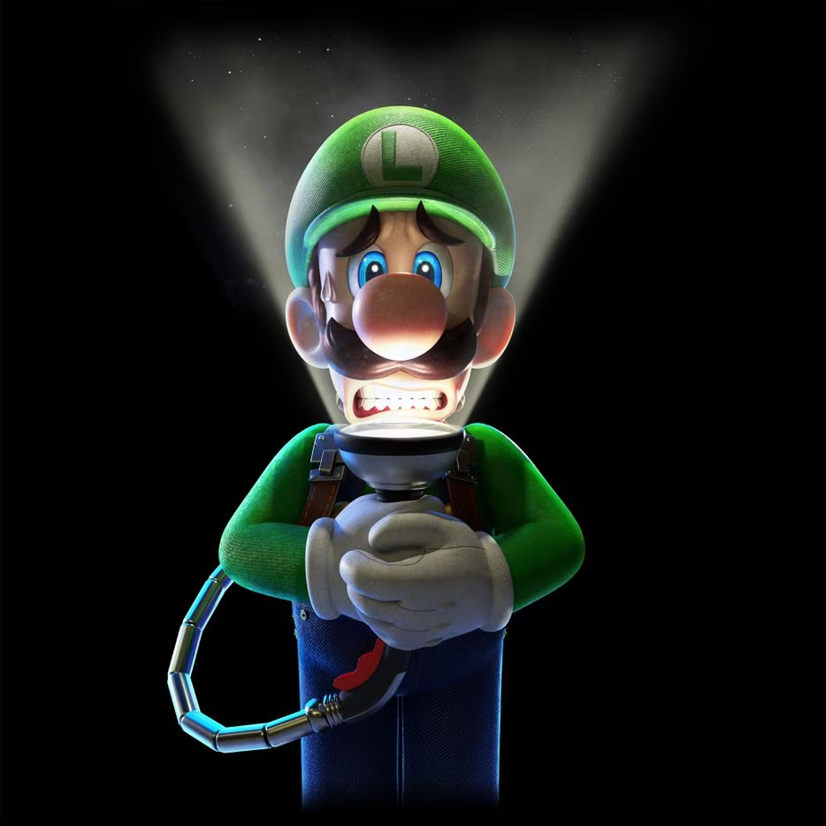
IDEA 3 - Scary Story w/ Sound
The sounds of the makey-makey can be used as a sound effect
The students can use these sound effects to for a scary story
We could also provide already written stories to read

Slide 5
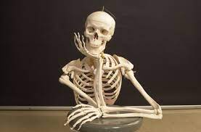
Special Implementation
Use playdoh to make themed objects
They playdoh can be then used to activate the makey makey
Try and use soundboard that is in the Digital Media Lab to create own sound
Implement a screen to project a jumpscare after activating

